Slide 1


AI-POWERD RESUME SCREENING AND RANKING SYSTEM
Name:-Halvadia Darshil Upendrabhai
E-mail:-djdarshil01@gmail.com

Slide 2
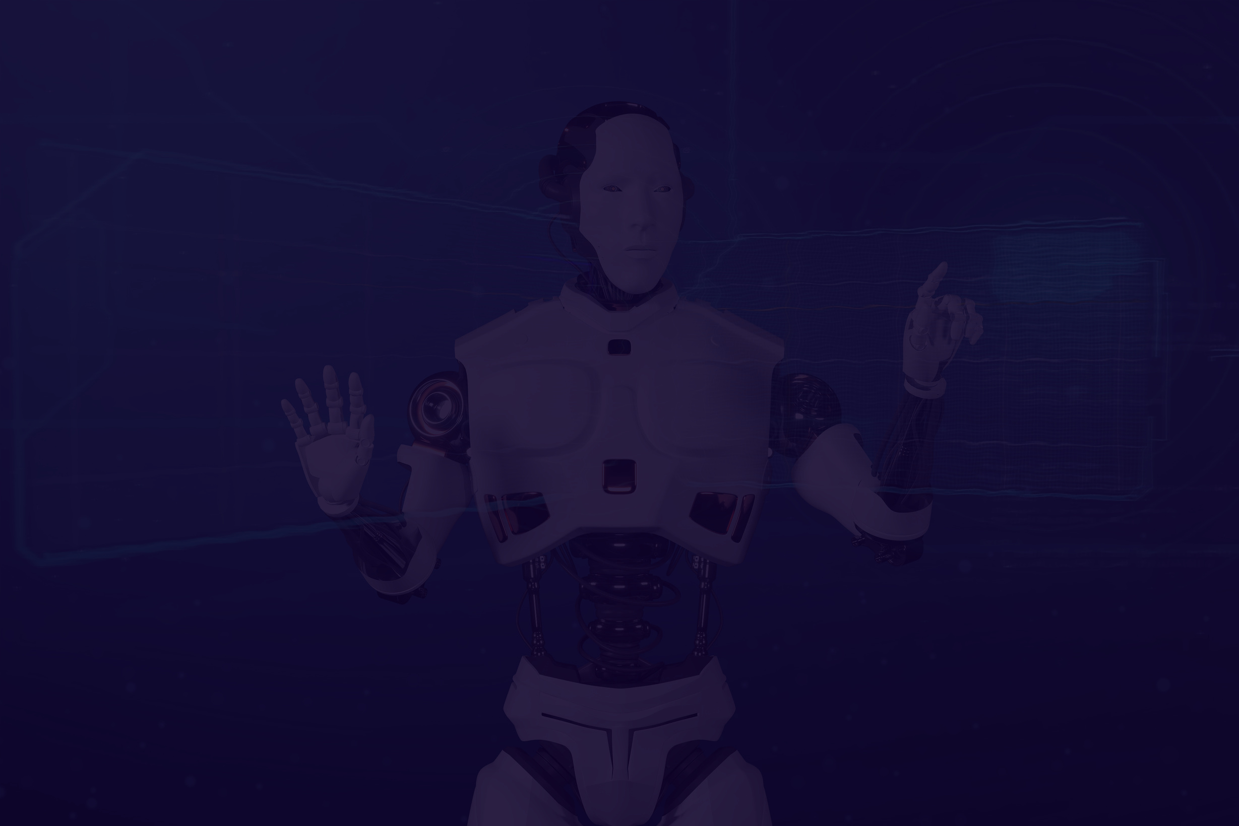
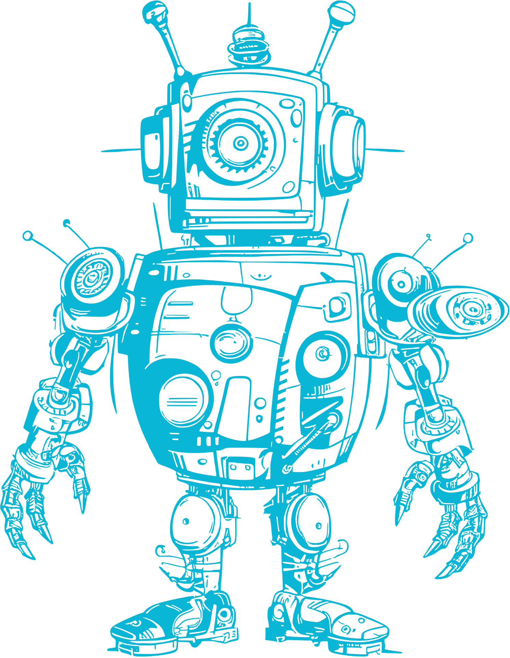

Project Overview
02
This project aims to automate the resume screening process using AI-based ranking algorithms. The system allows recruiters to upload multiple resumes, input a job description, and get ranked results based on relevance to the job role.
Key Highlights:
Uses TfidfVectorizer & Cosine Similarity for resume ranking.
Built with Streamlit for an interactive and user-friendly interface.
Supports multiple resume uploads and automated ranking.
Includes advanced UI styling with animations and CSS enhancements.
Objective:
To develop an efficient, unbiased, and automated resume screening system that helps recruiters save time and improve hiring decisions.
Would you like me to refine any specific details?

Slide 3


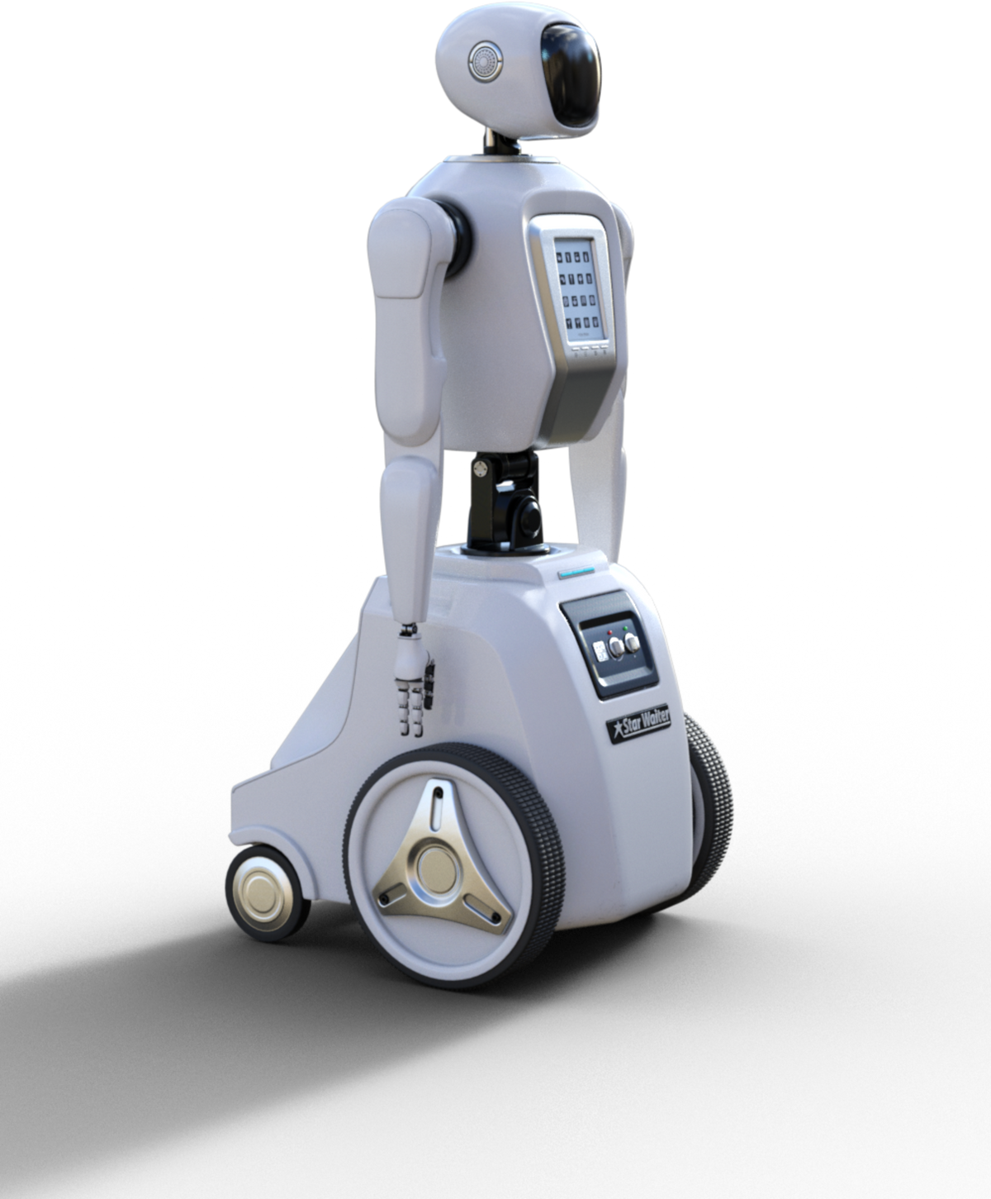
Problem Statement
Traditional resume screening is manual, time-consuming, and prone to bias.
Recruiters have to review hundreds of resumes manually, leading to inefficiency.
The goal is to automate resume screening using AI, making it faster, unbiased, and more efficient.
03

Slide 4



04
Methodology
Data Collection
Preprocessing
Model Selection
Gather relevant data from diverse sources.
Clean, normalize, and engineer data.
Choose and train ML/DL algorithms for peak performance.

Slide 5

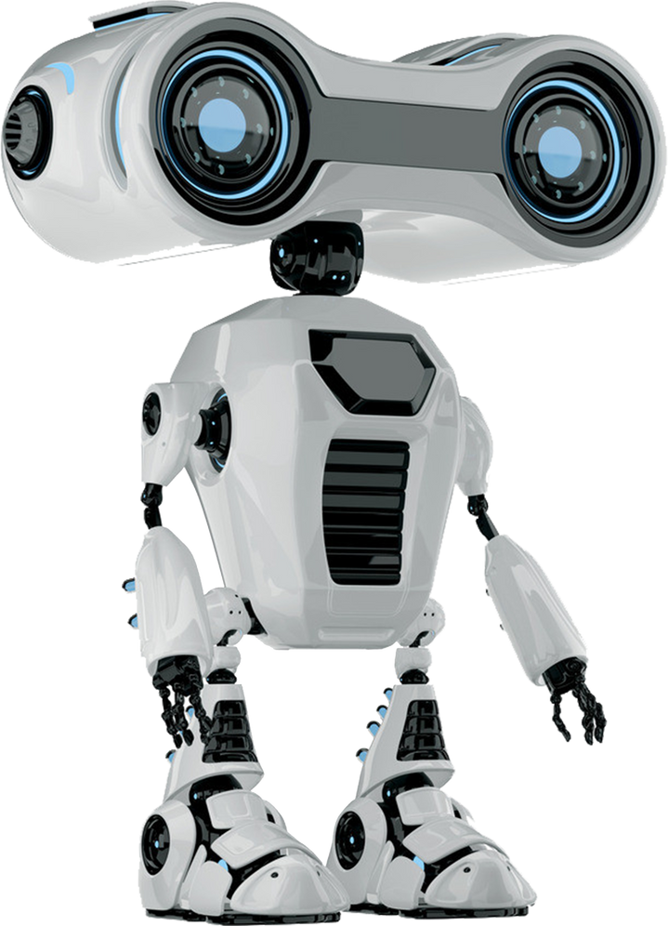
05
Software Requirements
Frontend: Streamlit (Python-based Web UI)
Backend: Python, Pandas, Scikit-learn
Additional Libraries:
PyPDF2 (for extracting text from resumes)
TfidfVectorizer, Cosine Similarity (for ranking)

Slide 6

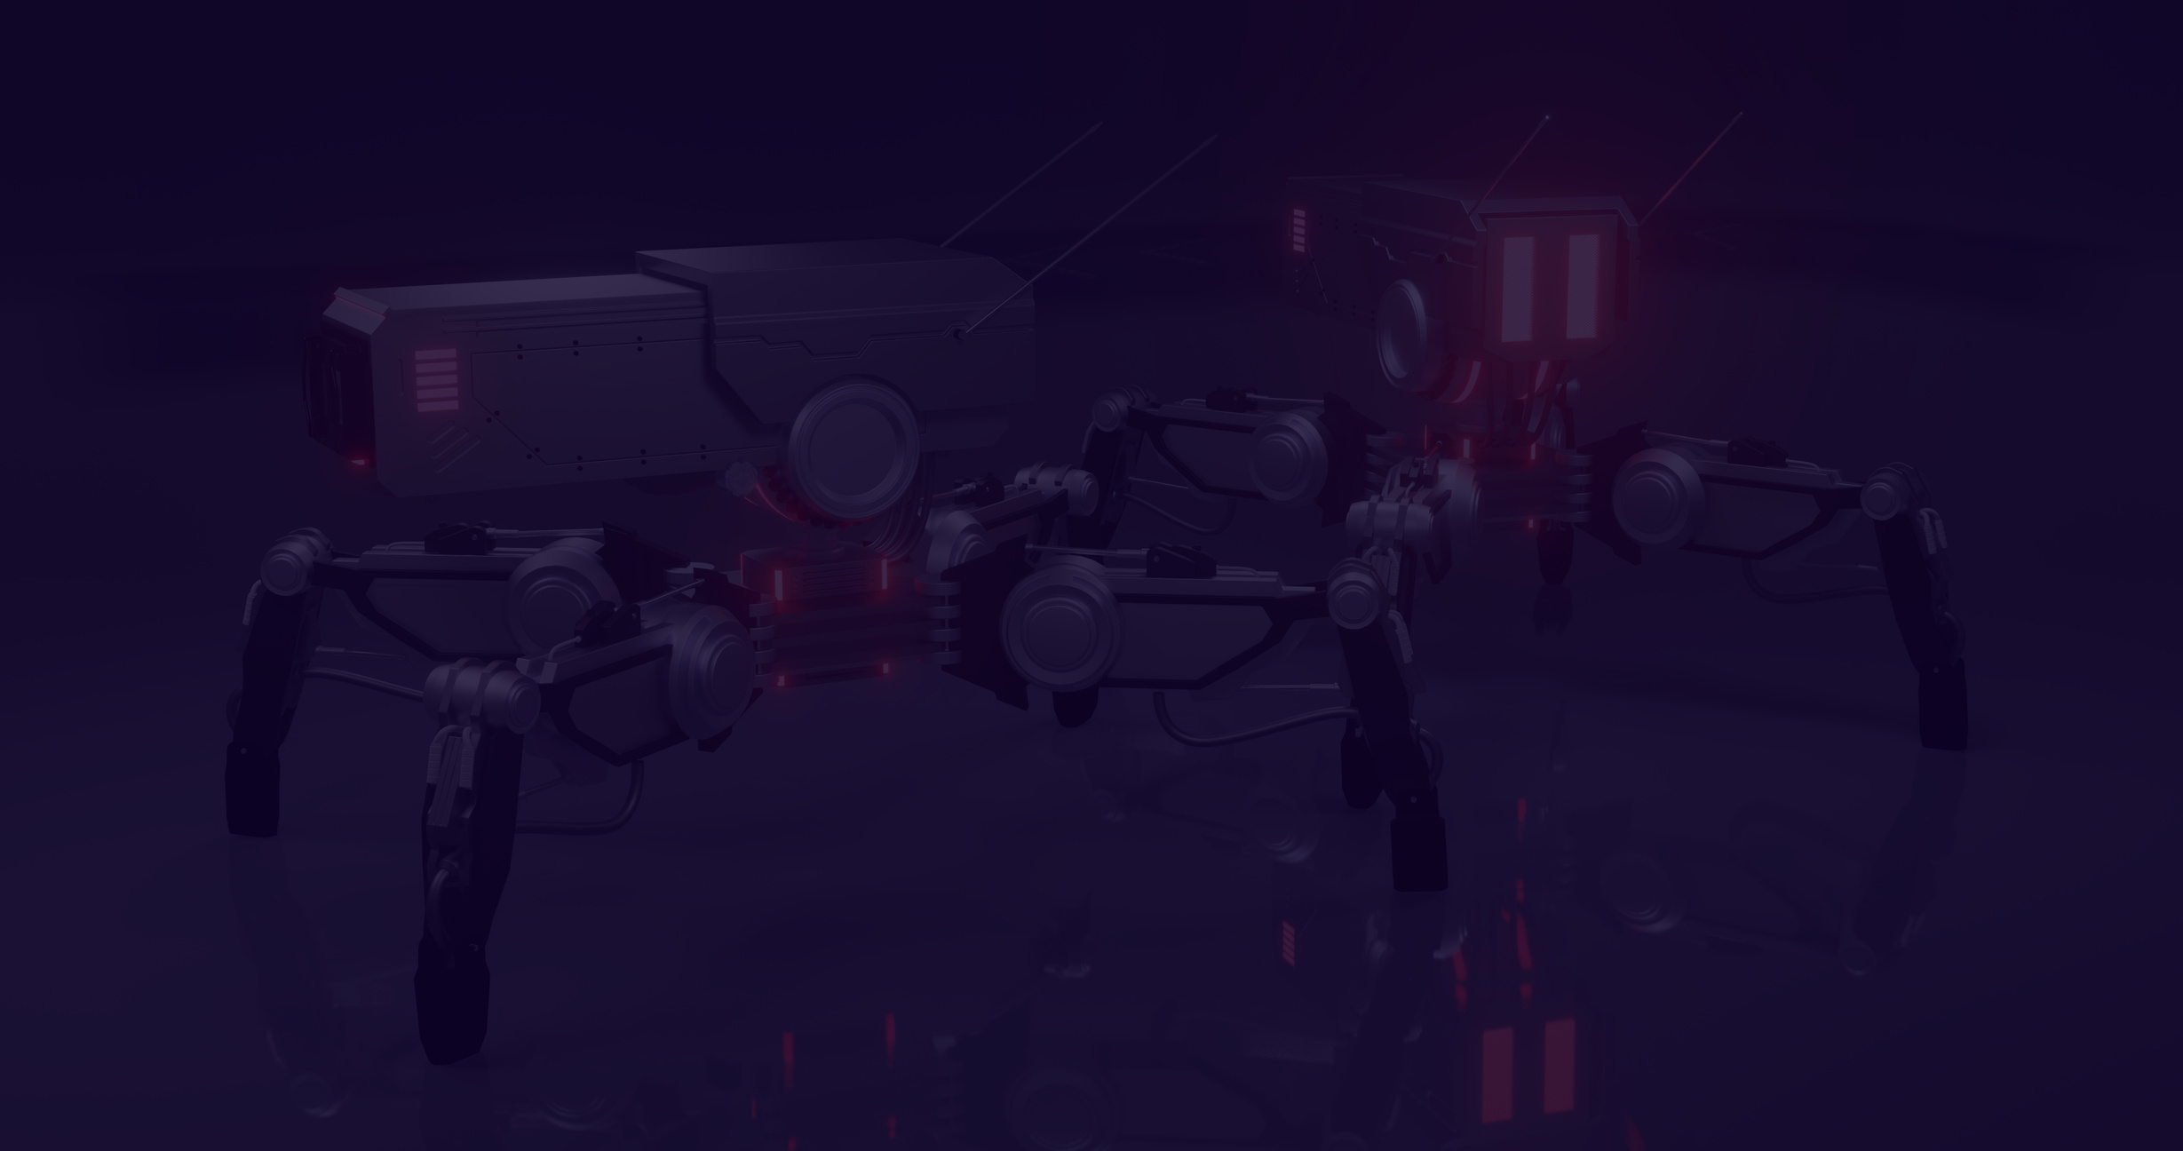

System Architecture
06
User uploads resumes (PDF format)
Job description is provided
AI model processes resumes and calculates relevance
System ranks resumes based on similarity score
Final output is displayed on the UI

Slide 7



07
Vison Of This Project
To create an AI-powered hiring assistant that helps recruiters save time and effort.
Ensure fair and unbiased resume evaluation.
Provide a modern, visually appealing, and user-friendly UI.

Slide 8


Result and Impact
We present the results of our AI project, showcasing improvements in performance, efficiency, and decision-making compared to traditional methods. We also discuss the potential impact of our solutions on stakeholders and end-users.
08

Slide 9


Future Directions
Integration with LinkedIn & job portals.
Support for multiple document formats (DOCX, TXT, etc.).
Improved ranking using deep learning (BERT, GPT-based models).
Automated feedback to candidates based on resume quality.

Slide 10




Thank You!
Get in touch with us
djdarshil01@gmail.com

